Slide 1


PATIENT CARE MANAGEMENT
SYSTEM FOR HEALTHCARE SERVICES
A Smart care AI Assistant
By Aditya Tiwari

Slide 2
PROBLEM STATEMENT
Fragmented booking — Patients had no way to see real appointment openings and had to call in blind → solved with a live specialty → doctor → date → open-slot booking flow.
No unified records — Vitals, prescriptions and reports lived across disconnected paper trails → solved with a single patient dashboard tracking vitals, history, and prescriptions together.
Uncontrolled doctor onboarding — No safeguard against anyone registering as a doctor → solved by restricting doctor account creation exclusively to the Admin.
Manual, error-prone prescribing — Handwritten prescriptions with no stock awareness → solved with catalog backed prescribing that deducts live stock automatically.
No self-service pharmacy access — Patients had to visit in person to check medicine availability or usage info → solved with an online pharmacy (browse, purchase, and ask the chatbot about any medicine).
No intelligent guidance — Patients had no simple way to get answers about their own care → solved with a role-aware AI chatbot scoped to each user's own data.
Manual document/photo interpretation — Patients couldn't get quick clarity on a medicine or report without a doctor visit → solved with OCR + AI-powered document and photo analysis directly in the chatbot.

Slide 3
Technologies Used
Category | Technologies
Frontend / Application | Streamlit, Custom CSS design system
Backend & Language | Python
Database & ORM | MySQL, SQLAlchemy
Security | bcrypt (password hashing)
Configuration | python-dotenv
Data Visualization | Plotly / Streamlit native charts
AI Agent Framework | LangChain
LLM & Vision AI | Groq (LLM hosting), Vision-capable LLM
OCR / Document Processing | PaddleOCR, Tesseract, pypdf
Speech-to-Text | Groq Whisper API
Text-to-Speech | Web Speech API (browser-native)
PDF Generation | xhtml2pdf
Email Delivery | smtplib, Gmail SMTP, HTML email templates

Slide 4
Milestone 1-
Authentication & role-based access
Milestone Overview:
Built the entry point of the system: role-based Login and Signup.
Self-registration available only for Patients (and optionally Doctors registering themselves, depending on your final config) via a signup form.
Doctor accounts are created exclusively by the Admin — no doctor self-registration — to keep clinical staff credentials controlled.
Passwords are never stored in plain text — hashed using bcrypt before saving.
Login validates credentials, checks account active/inactive status, and routes the user into the correct role-based dashboard

Slide 5
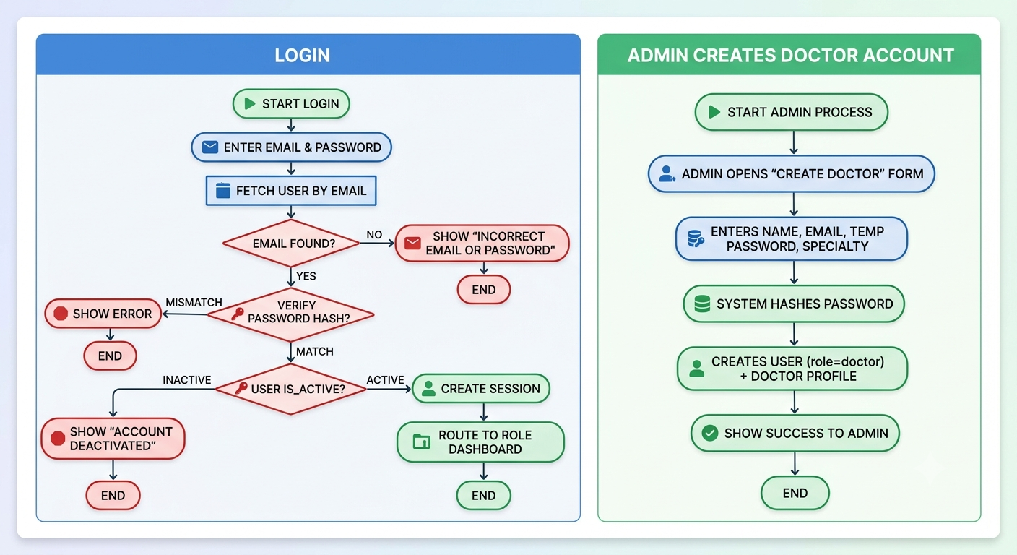
Flowchart: Login & Admin-created account
Average Annual Revenue per Doctor
Market Growth Per Year

Slide 6
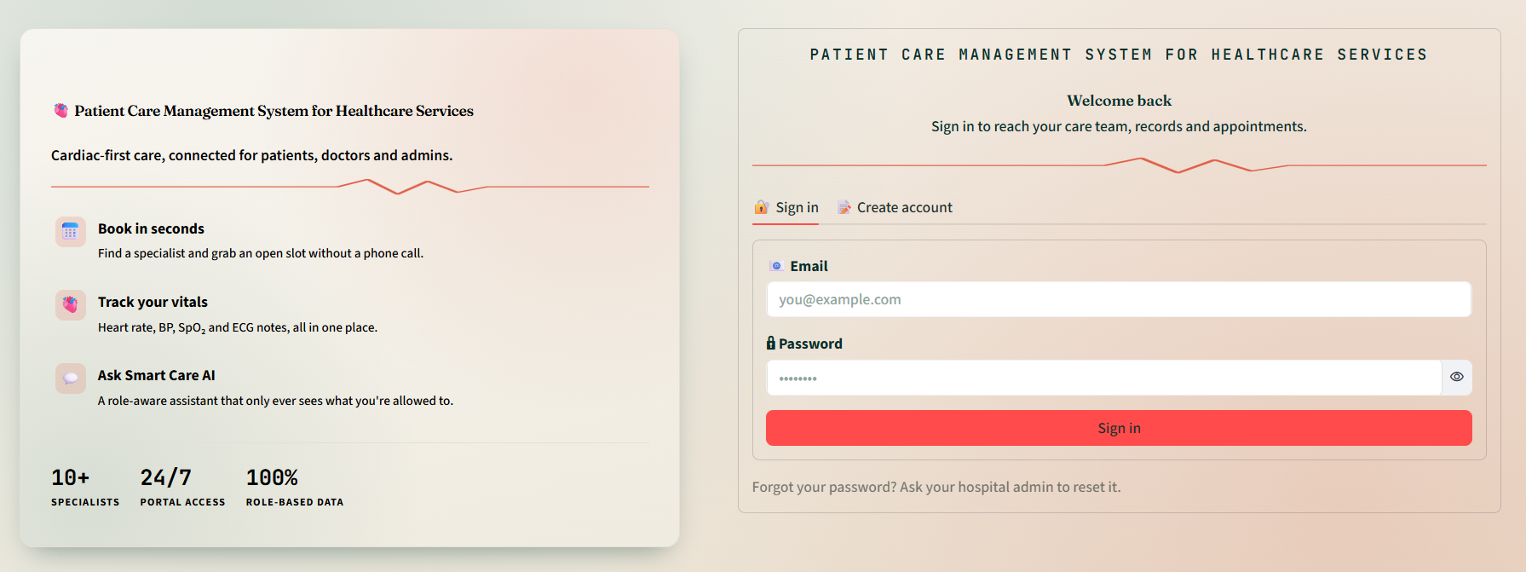
Login Screen

Slide 7
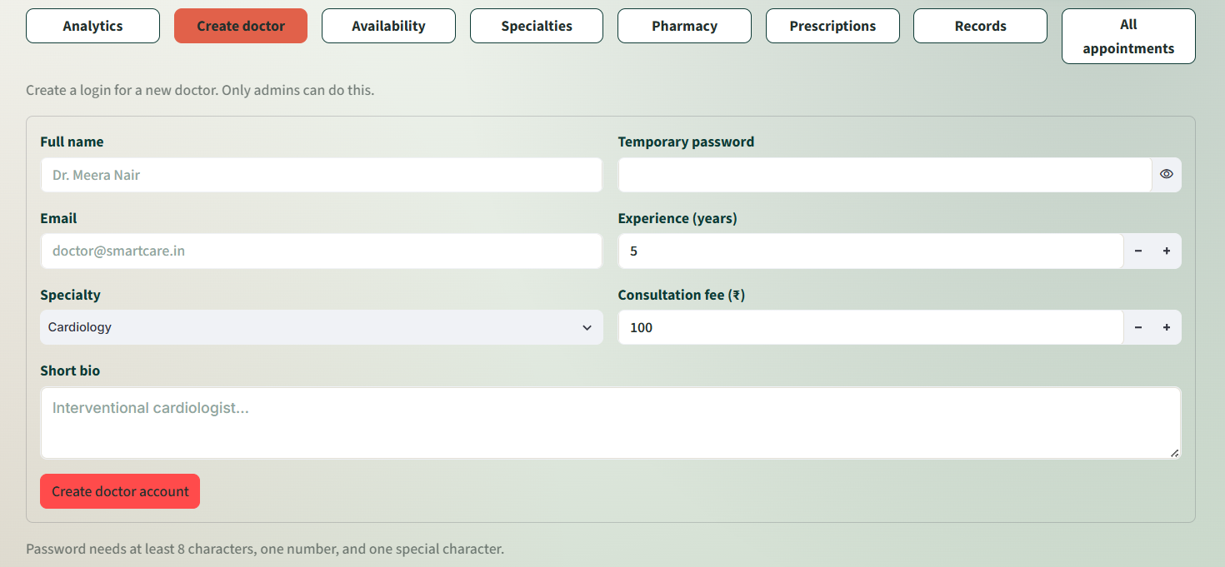
Admin “Create Doctor” Form

Slide 8
Milestone 2- Role-based UI
Milestone Overview:
Built three distinct, dedicated dashboards on top of the authentication foundation from Milestone 1.
Each role sees only its own navigation and data — enforced both visually (sidebar) and at the data-access level.
Admin's console is the control center — manages both patient and doctor accounts, specialties, and oversees system-wide activity.
Patient dashboard: vitals overview, health record history, doctor directory.
Doctor dashboard: profile, schedule, appointment list.

Slide 9
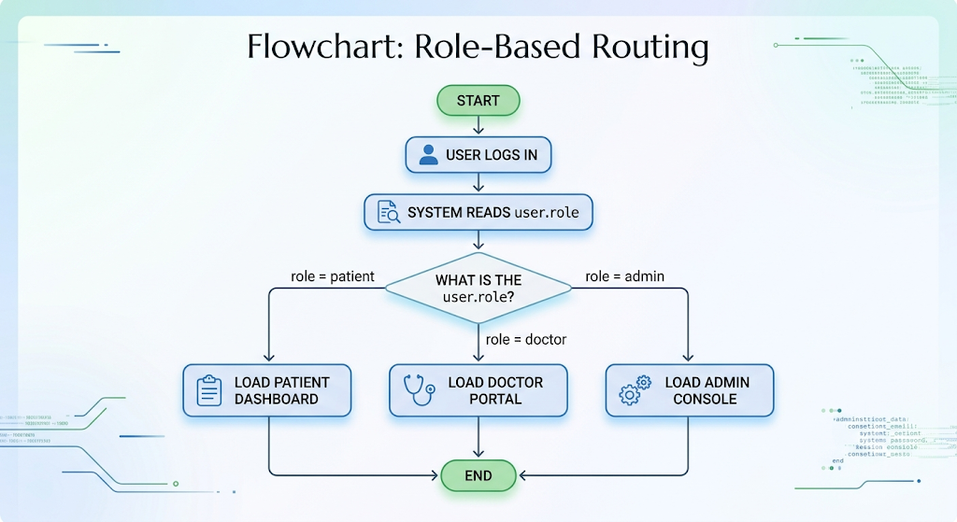
Flowchart: Role-Based Routing
Average Annual Revenue per Doctor

Slide 10
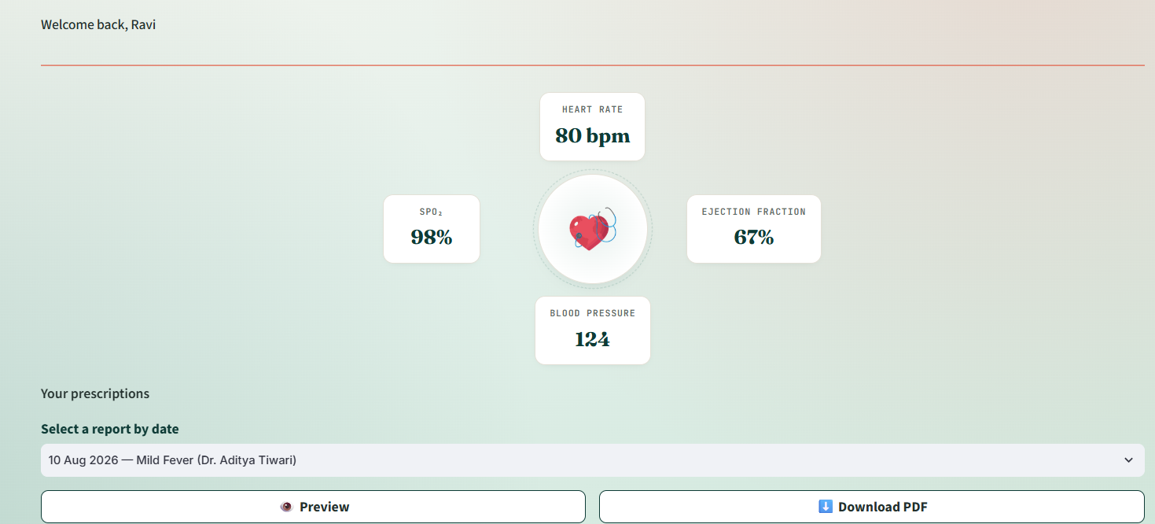
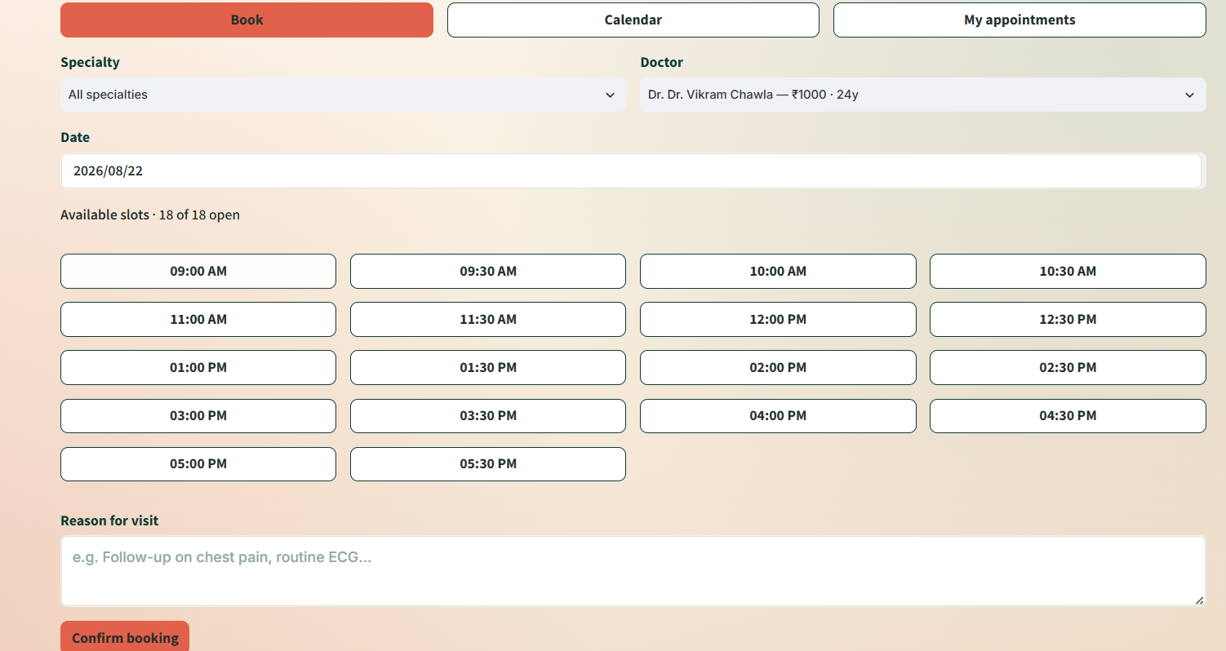
Patient Dashboard

Slide 11
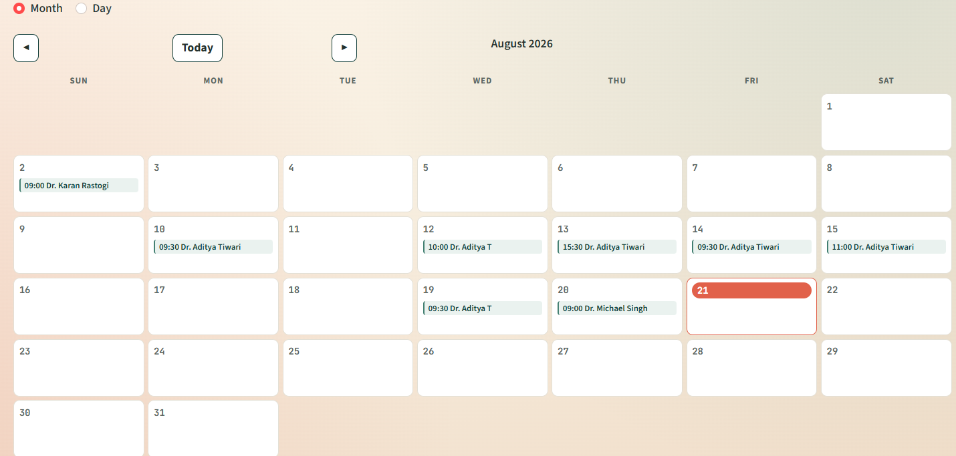

Slide 12
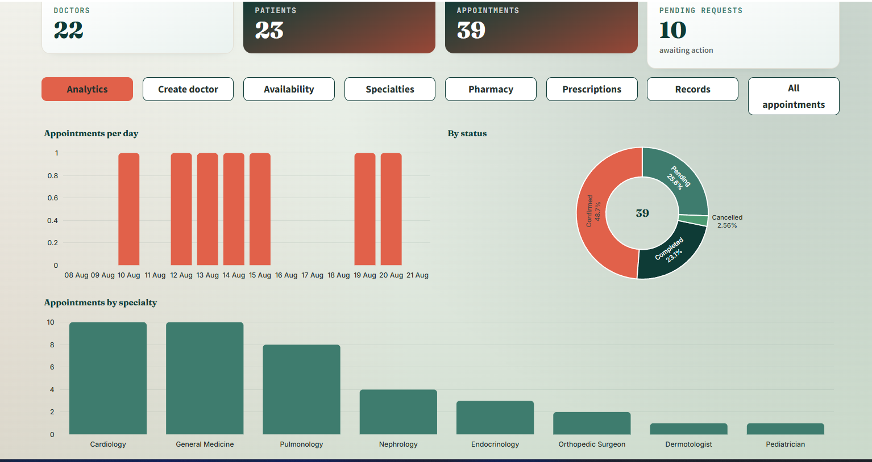
Admin Console

Slide 13
Milestone 3- Pharmacy, Chatbot
& Doctor Reports
Milestone Overview:
Pharmacy module: Admin performs full CRUD on medicines (add, price, restock, remove); patients browse the catalog, view medicine details, and purchase.
Chatbot: an AI assistant embedded in every role's portal, managing role-specific tasks conversationally — appointments/vitals for patients, schedule/prescribing for doctors, inventory/analytics for admin.
Doctor health reports: doctors build a report (medicines + vitals + diagnosis + advice) with a live preview that updates as they type; patients can view and download the finished report as a PDF.

Slide 14
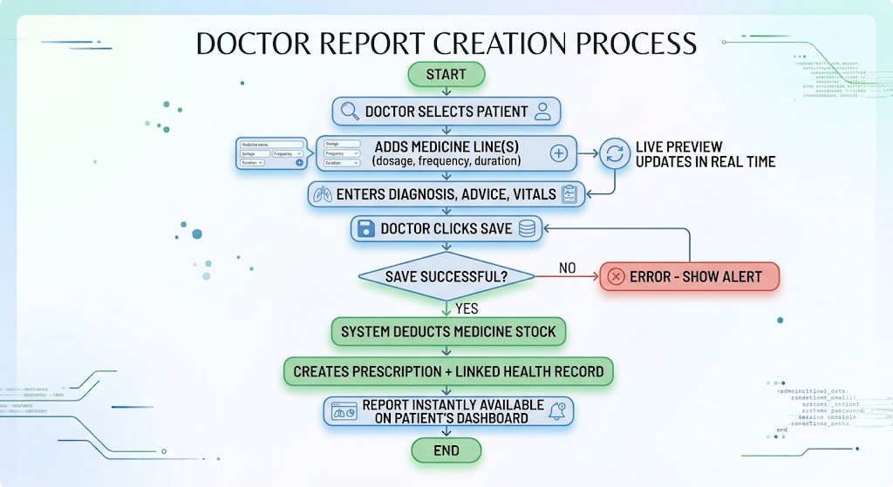
Flowchart: Doctor report creation
Average Annual Revenue per Doctor

Slide 15
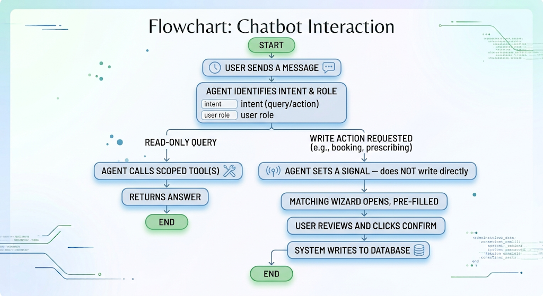
Flowchart: chatbot interaction
Average Annual Revenue per Doctor

Slide 16
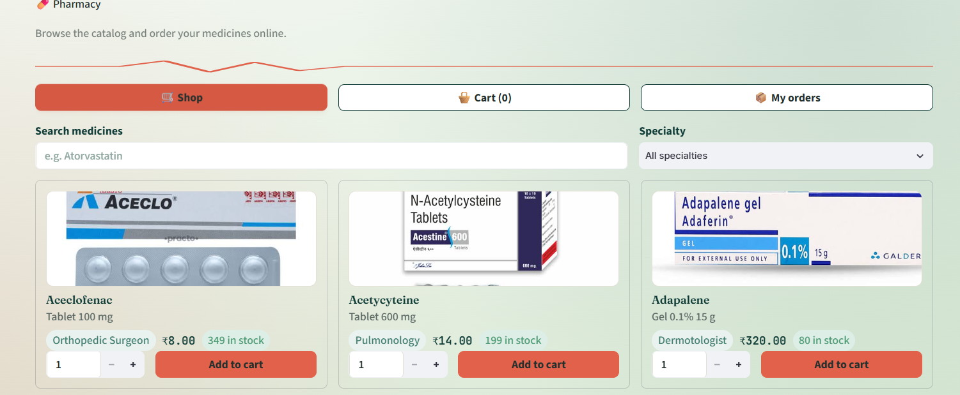
Pharmacy shop / cart

Slide 17
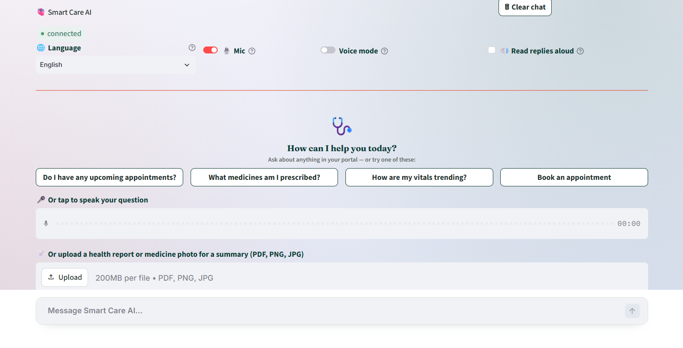
Chatbot Conversation

Slide 18
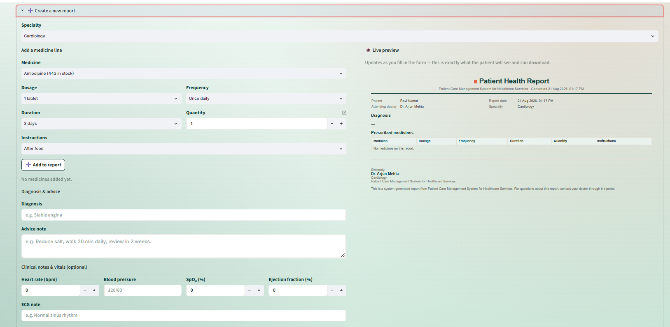
Doctor Report Live Preview

Slide 19
Milestone 4- OCR, Email
Notification & voice assistant
Milestone Overview:
OCR intelligence: patients can upload a photo of a medicine or a health report directly in the chatbot; the system extracts the text and returns a structured, AI-generated explanation.
External connectivity — email notifications: enhances Milestone 1's doctor-creation flow — when the Admin creates a doctor account, the doctor now automatically receives a branded welcome email with their login credentials.
Voice assistant: adds speech-to-text (mic input) and text-to-speech (spoken replies) to the chatbot, enabling a real conversational experience.

Slide 20
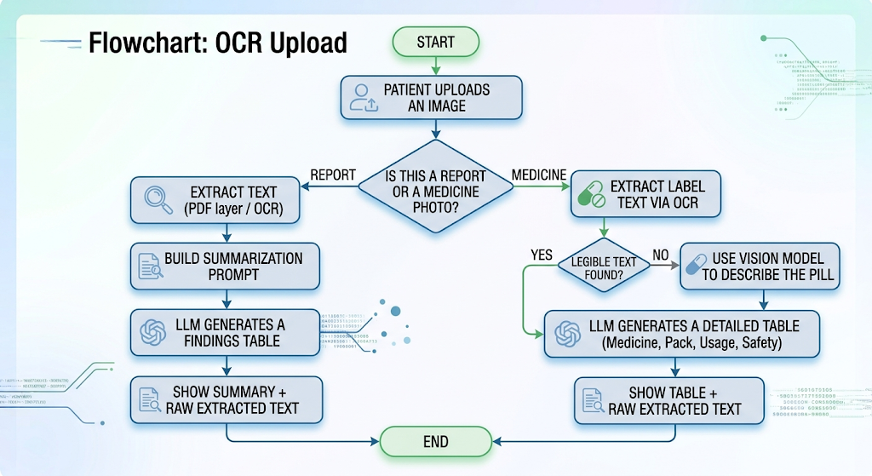
Flowchart: OCR Upload
Average Annual Revenue per Doctor

Slide 21
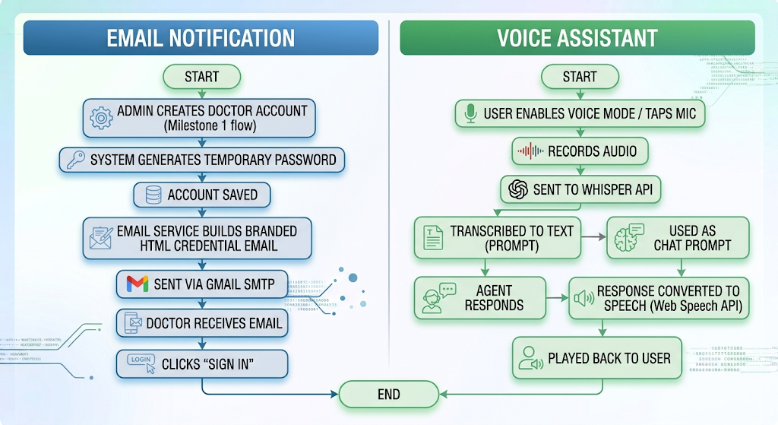
Flowchart: email notification & voice assistant
Average Annual Revenue per Doctor

Slide 22
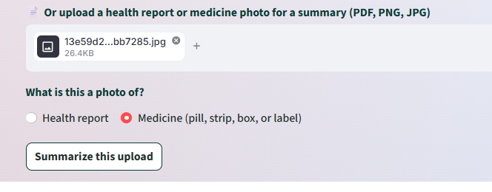
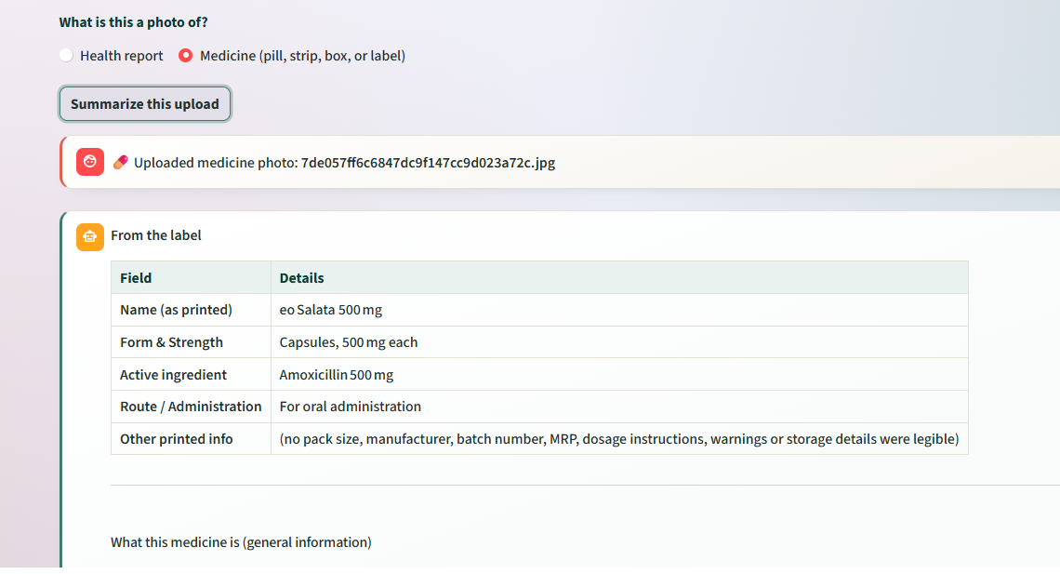
OCR Result / Medicine Table

Slide 23
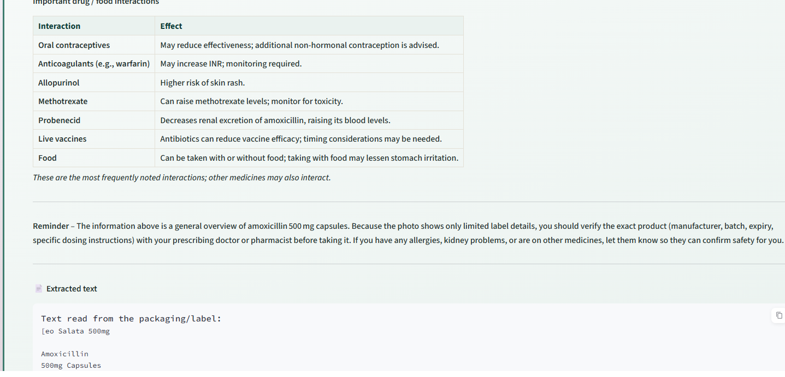
Important Notes and Extracted
OCR Text

Slide 24
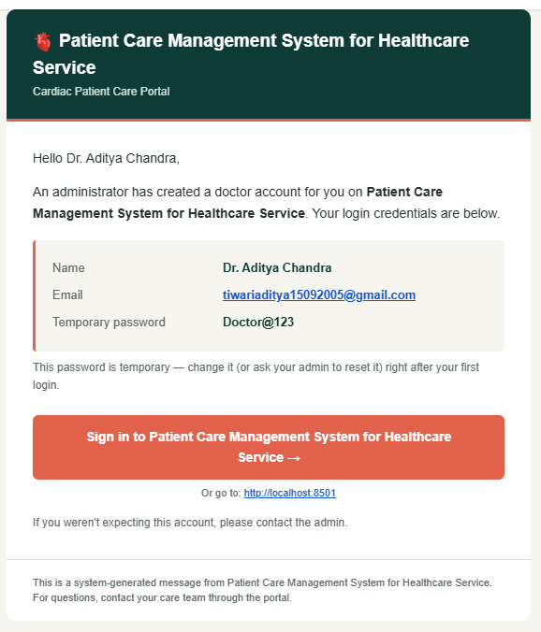
Doctor’s Welcome Email

Slide 25
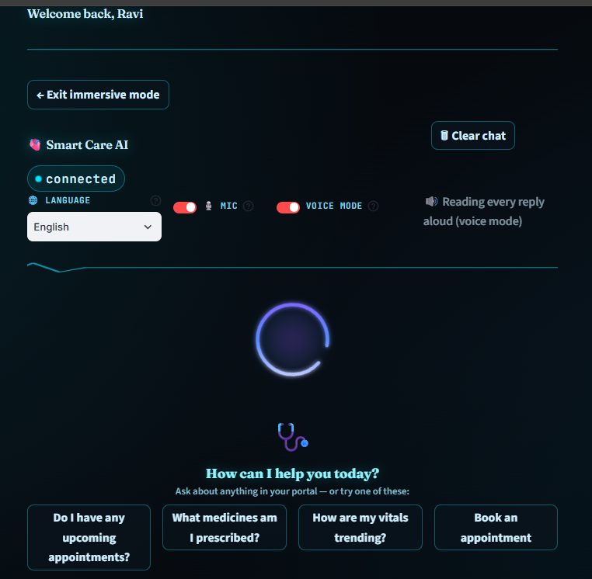
Voice Mode UI

Slide 26
Challenges Faced
Inconsistent name formatting — some doctor records stored "Dr." as part of the name while UI templates also prepended it, causing "Dr. Dr. [Name]" bugs across multiple screens; fixed by centralizing name-display logic in one place.
Unsafe rendering of free-text fields — doctor-entered notes injected raw into HTML could break the layout; fixed by escaping all user-entered text before rendering.
Dependency version conflicts — LangChain, langchain-core, and langchain-groq versions drifting out of sync caused import errors that needed careful pinning.
OCR environment setup — getting Tesseract's binary correctly recognized on Windows (PATH issues) required a fallback to a hardcoded install-path check.
Balancing AI flexibility with data safety — ensuring the chatbot could never directly write to the database; solved with a strict "propose → human confirms" wizard pattern for every write action.
Handling ambiguous photo uploads — distinguishing a medicine label (OCR-readable) from a bare pill (needs a vision model) required a two-path extraction pipeline with graceful fallback.
Email deliverability — configuring Gmail SMTP correctly (App Passwords vs. regular password) and avoiding spam-folder placement on first send.

Slide 27
Future Scope
Global cross-portal search across patients, doctors, and medicines.
Medication reminders using existing prescription duration data.
One-click magic-link sign-in directly from email notifications.
Click-to-book appointments directly on the doctor's schedule grid.
A true light/dark theme toggle across the entire app, not just the chatbot.
Native mobile app version for patients and doctors.
Integration with a real payment gateway for the pharmacy module.
Telemedicine / video consultation support.
Multi-hospital / multi-tenant deployment support.
Expanded language coverage beyond the current 11 supported languages.

Slide 28
Thank you

